Slide 1
ON-DEMAND CAR WASH APP
Submitted By:
Adhi Shankar V (150071601007)
S. Aravind Kumar (150071601013)
Basheer Ahamed A (150071601018)

Slide 2
INTRODUCTION
Usage of cars is very common these days. There is at least one car for every family . Buying a car is easy but maintaining it is the most difficult task. It requires frequent visit to the servicing centers for washing and servicing. Doing all these works consumes lots of time and money. In today’s busy world no one finds that time though they have money to do all of it.
To avoid this problem the app On demand car wash will be required.

Slide 3
ABSTRACT
On- demand car wash is an android application that is designed to provide car servicing to the people when needed.
This project is about creating an intelligent On-demand car wash app using android studio.
The key benefit of this project is that the users need not bring the vehicle to the service providers instead the service providers will come to the users location for car washing and servicing.

Slide 4
PURPOSE
The objective of this project is to provide on demand mobile service for the customers who require servicing for their cars.
This on-demand app is a combination of ease and amenity that saves time of people meanwhile giving employment opportunities to the hidden talents of the skilled artist or professionals.

Slide 5
PROJECT SCOPE
For future work this app can also contains various packages and add-ons to wipe, clean and dress your entire car from inside out.
One other feature could be, users can even schedule future car wash and give reviews and ratings to washers.
Another feature could be, if the Car wash service provider is far away from the customer, then it automatically directs the nearby car wash service to the customers.

Slide 6
SYSTEM REQUIREMENT
Hardware:
Processor : Intel Core i5 (5th Gen.)
RAM : 8GB DDR3L memory
Monitor : 39.62 cm (15.6) screen size
Hard Disk : 1000GB capacity
Keyboard : Alphanumeric keyboard
Mouse : Touchpad
Software:
Front End : Android Studio
Back End : SQL Lite/Google Firebase
Operating System : Windows 7,8,10, Android
Designing Software : Rational Rose

Slide 7
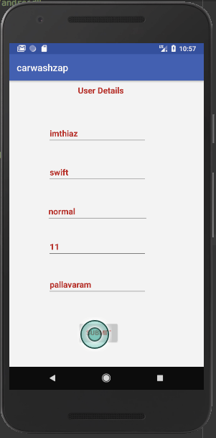
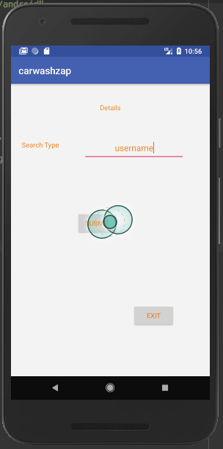
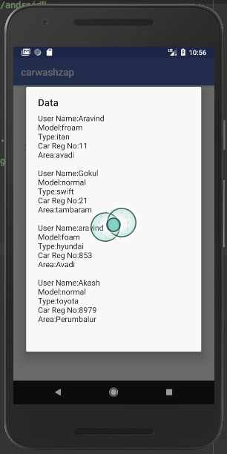

Slide 8
CONCLUSION
The On-Demand Car Wash App is developed using Android Studio, fully meets the objectives of the system which it has been developed. The system has reached a steady state where all bugs have been eliminated. The system is operated at a high level of efficiency and all the users associated with the system understands its advantage. The system solves the problem. It was intended to solve as requirement specification.
The project has a very vast scope in future. Project can be updated in near future as and when requirement for the same arises, as it is very flexible in terms of expansion.

Slide 9
THANK YOU!!

